Slide 1
Unit - 7
Application Layer
Prachi Shah
IT Dept.
BVM

Slide 2
Contents
1. | DNS: The DNS name space Resource records Name servers | [Tenanbaum 7.2]
2. | Electronic mail: Architecture and services User agent Message formats Message transfer Final delivery | [Forouzan 26.2 & Tenanbaum 7.3]
3. | World Wide Web: Architectural overview HTTP | [Forouzan 27.1, 27.2, 27.3]

Slide 3
DNS – The Domain Name System
The DNS Name Space
Resource Records
Name Servers

Slide 4
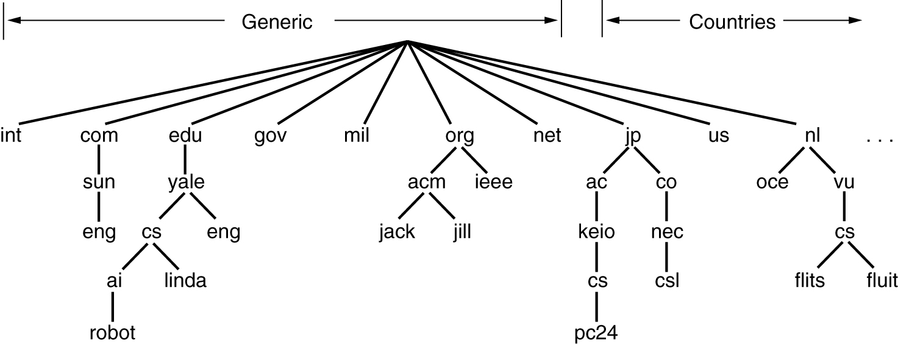
The DNS Name Space
A portion of the Internet domain name space.

Slide 5
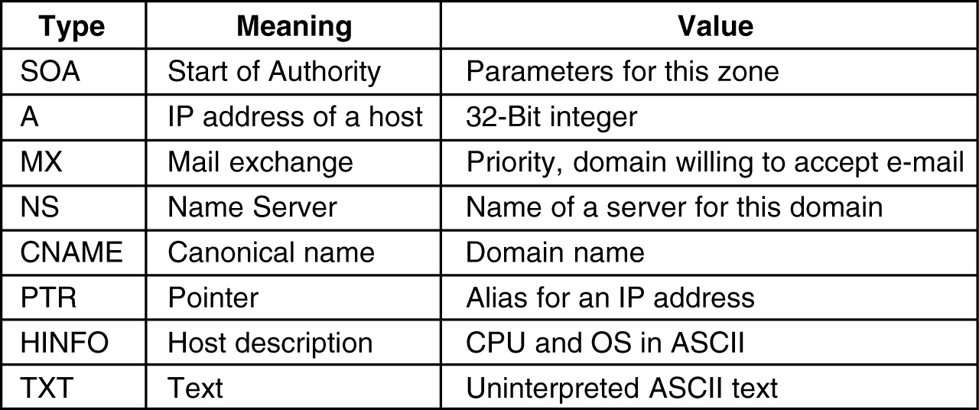
Resource Records
Format:
Domain_name Time_to_live Class Type Value
The principal DNS resource records types

Slide 6
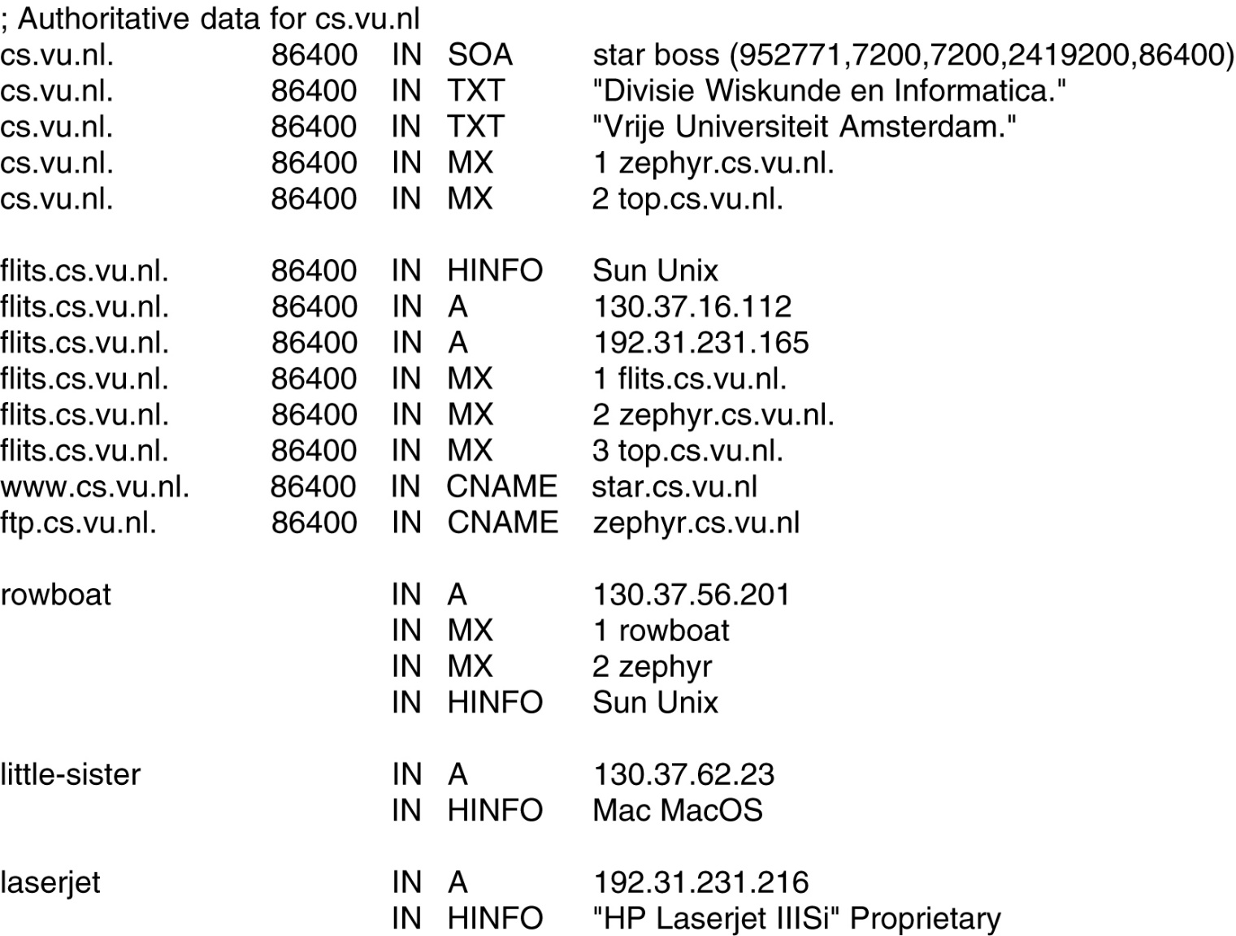
Resource Records (2)
A portion of a possible DNS database for cs.vu.nl.

Slide 7
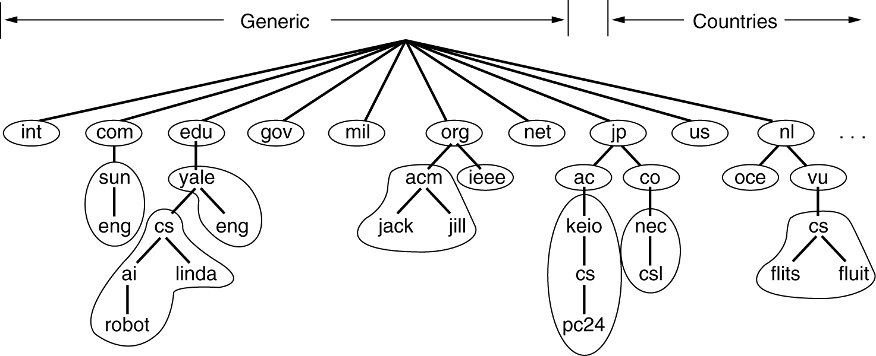
Name Servers
Part of the DNS name space showing the division into zones.

Slide 8
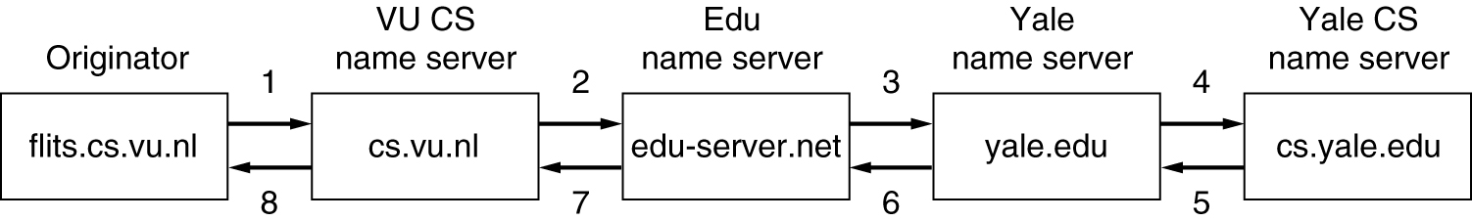
Name Servers (2)
How a resolver looks up a remote name in eight steps.

Slide 9
26-2 ELECTRONIC MAIL
One of the most popular Internet services is electronic mail (e-mail). The designers of the Internet probably never imagined the popularity of this application program. Its architecture consists of several components.
Two subsystems of Email:
User agents (UA) – local programs for command-based, menu based or graphical method interaction
Message transfer agents (MTA) – processes that run in background to move email through the system

Slide 10
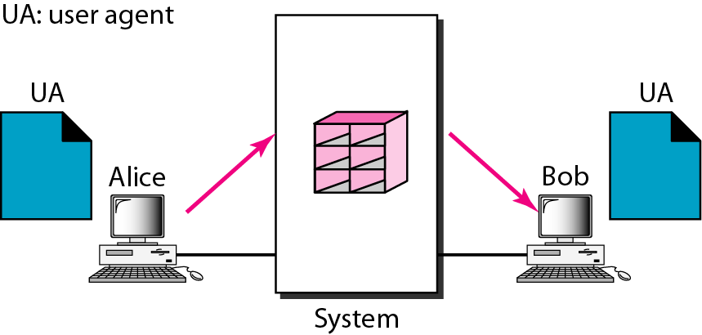
Figure 26.6 First scenario in electronic mail
When the sender and the receiver of an e-mail are on the same system,
we need only two user agents.

Slide 11
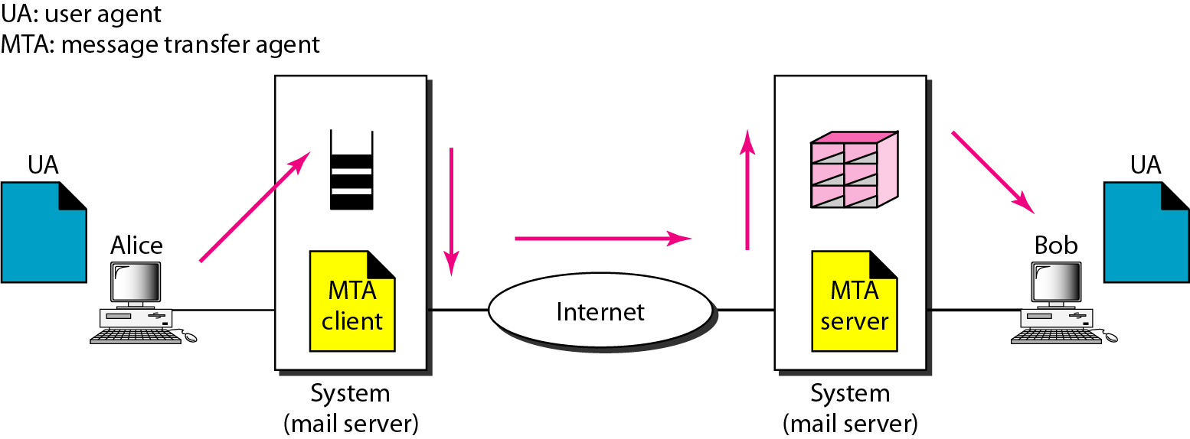
Figure 26.7 Second scenario in electronic mail
When the sender and the receiver of an e-mail are on different systems, we need two UAs and a pair of MTAs (client and server).

Slide 12
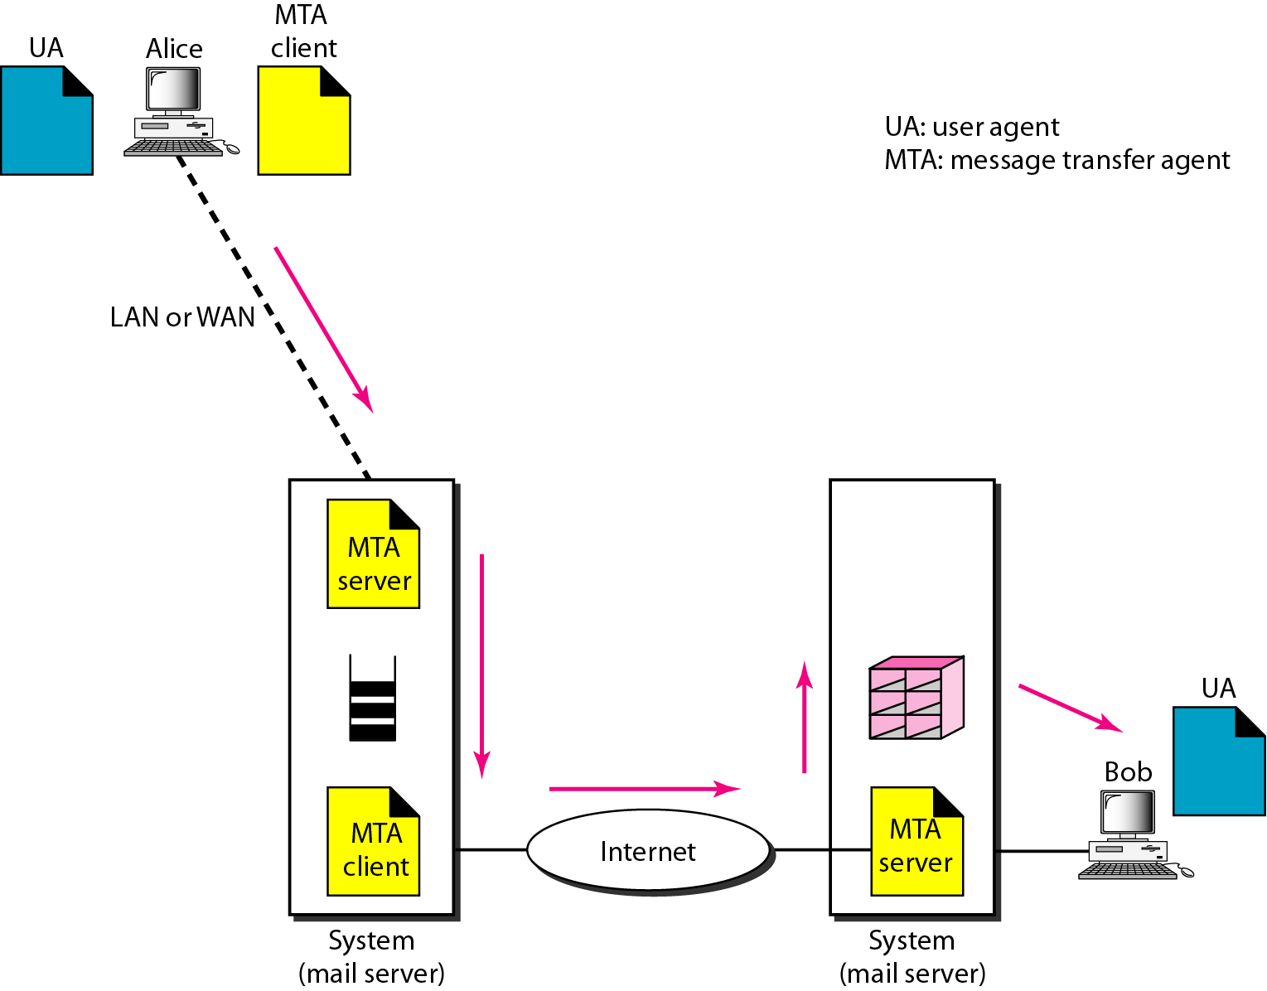
Figure 26.8 Third scenario in electronic mail
When the sender is connected to the mail server via a LAN or a WAN,
we need two UAs and two pairs of MTAs (client and server).

Slide 13
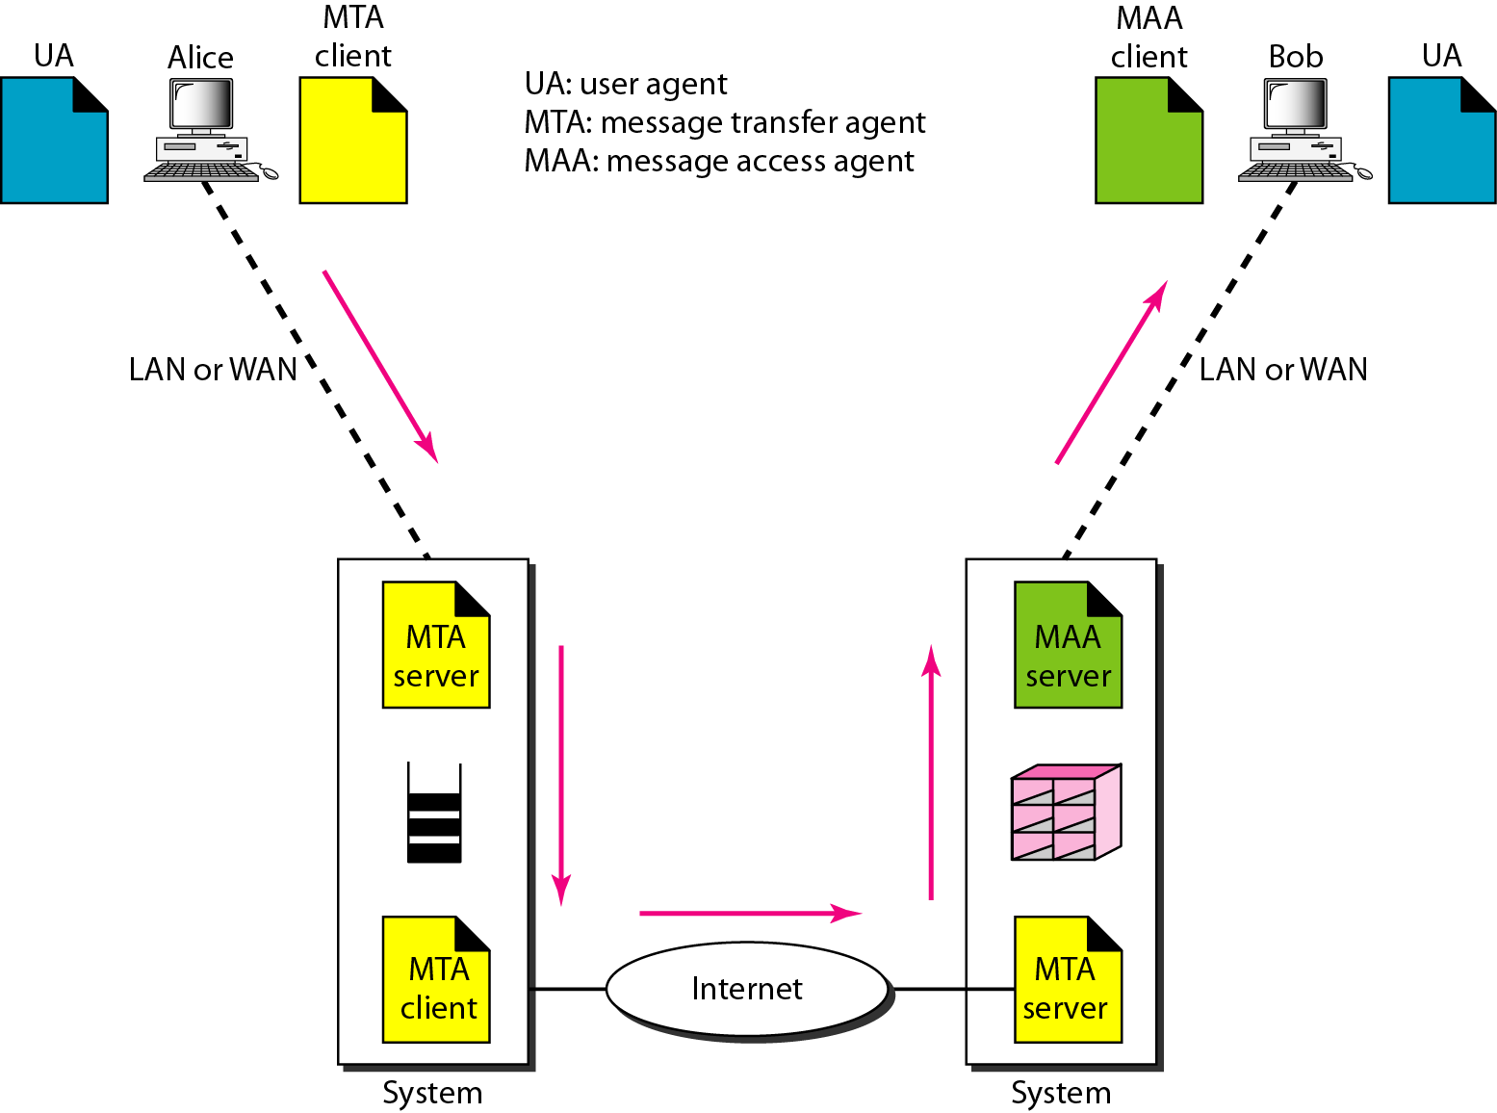
Figure 26.9 Fourth scenario in electronic mail
When both sender and receiver are connected to the mail server via
a LAN or a WAN, we need two
UAs, two pairs of MTAs
and a pair of MAAs.
This is the most common situation today.

Slide 14
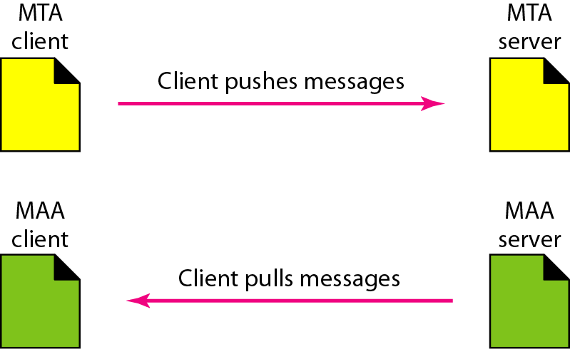
Figure 26.10 Push versus pull in electronic email

Slide 15
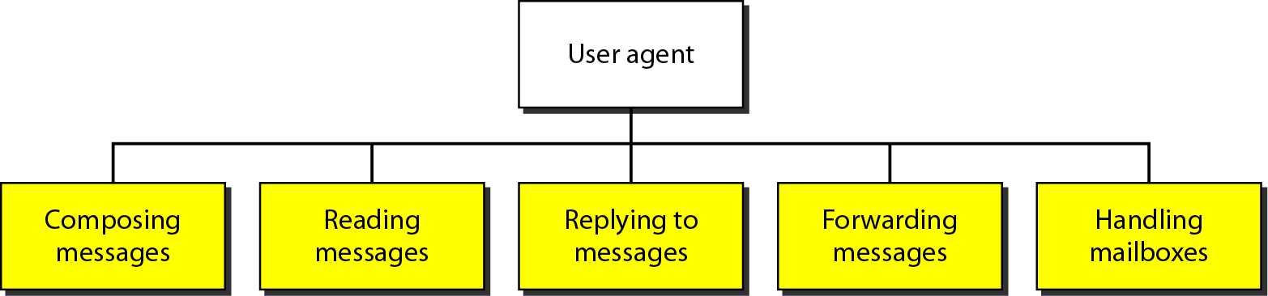
Figure 26.11 Services of user agent

Slide 16
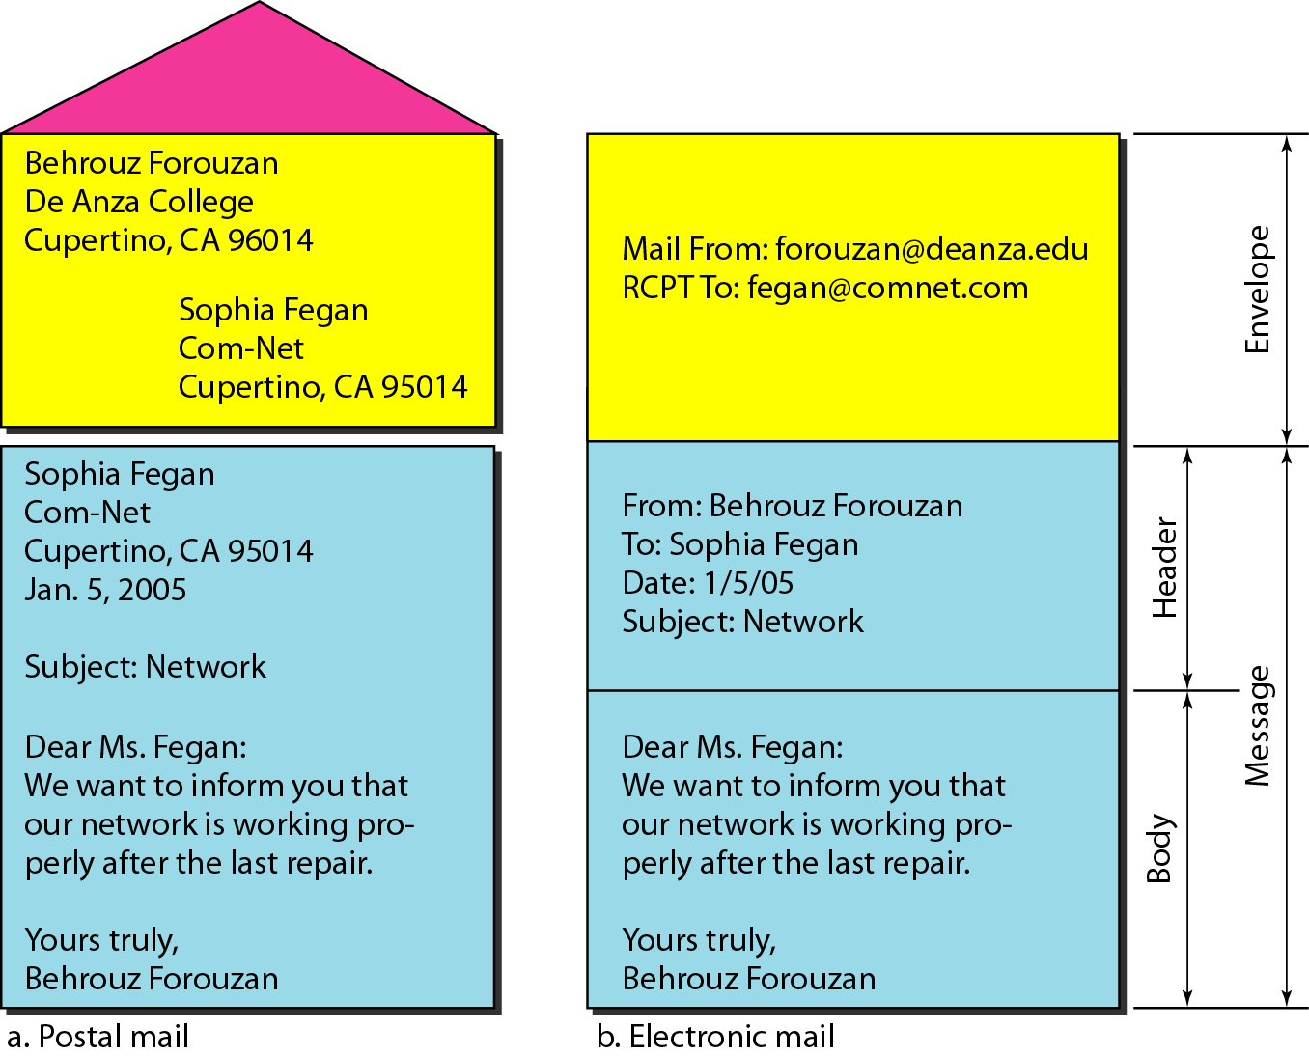
Figure 26.12 Format of an e-mail

Slide 17
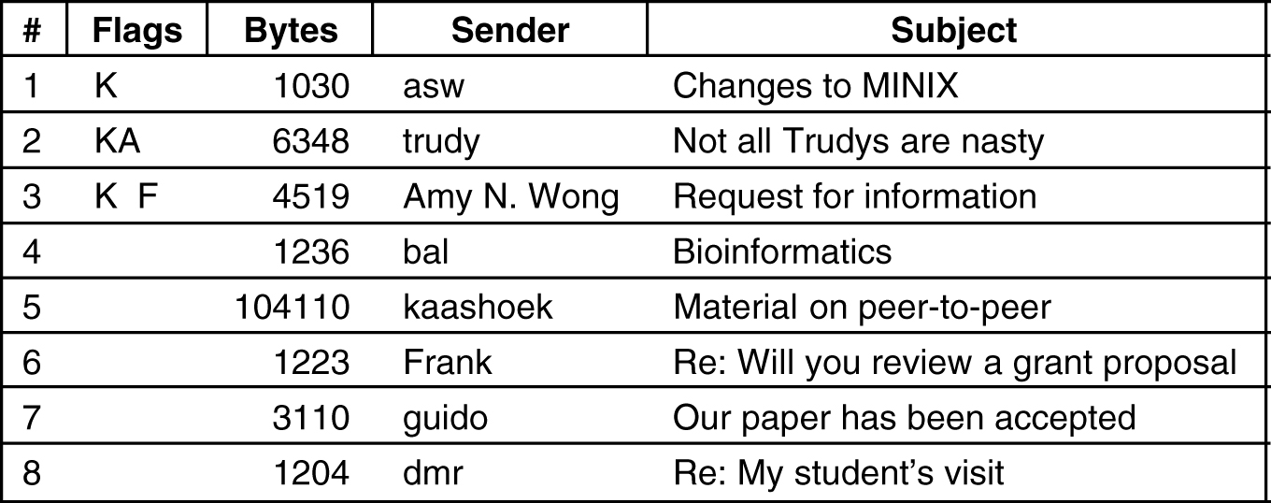
Reading E-mail
An example display of the contents of a mailbox.

Slide 18
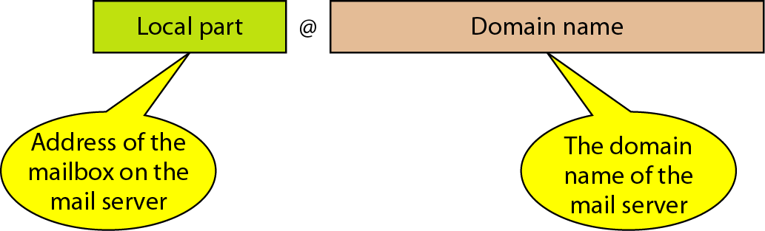
Figure 26.13 E-mail address

Slide 19
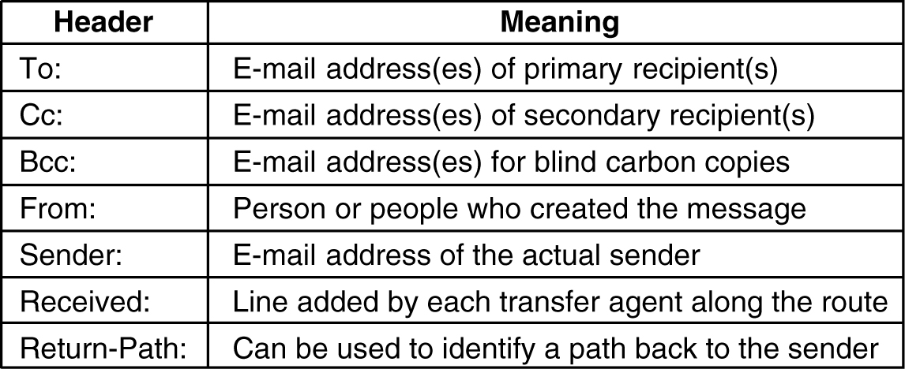
Message Formats – RFC 822
RFC 822 header fields related to message transport.

Slide 20
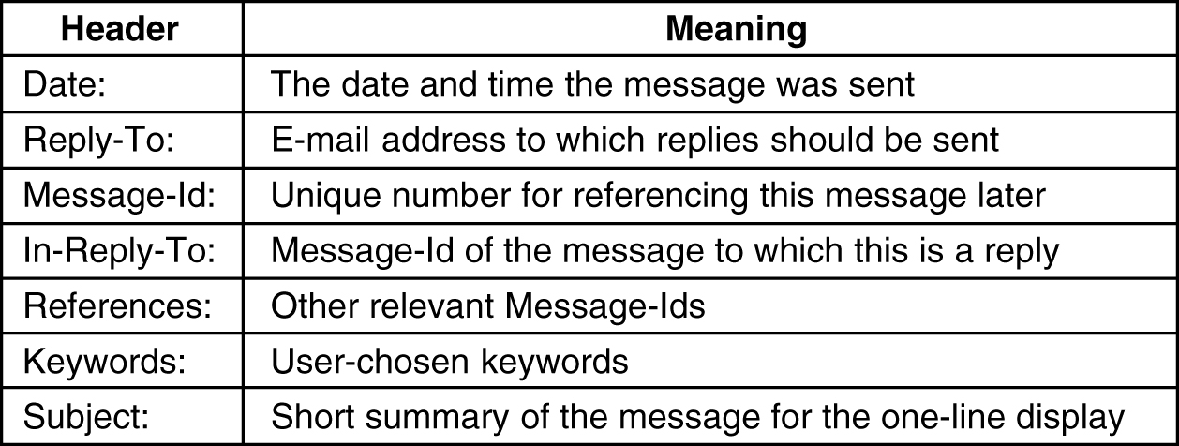
Message Formats – RFC 822 (2)
Some fields used in the RFC 822 message header.

Slide 21
MIME – Multipurpose Internet Mail Extensions
Problems with international languages:
Languages with accents (French, German).
Languages in non-Latin alphabets (Hebrew, Russian).
Languages without alphabets (Chinese, Japanese).
Messages not containing text at all (audio or images).

Slide 22
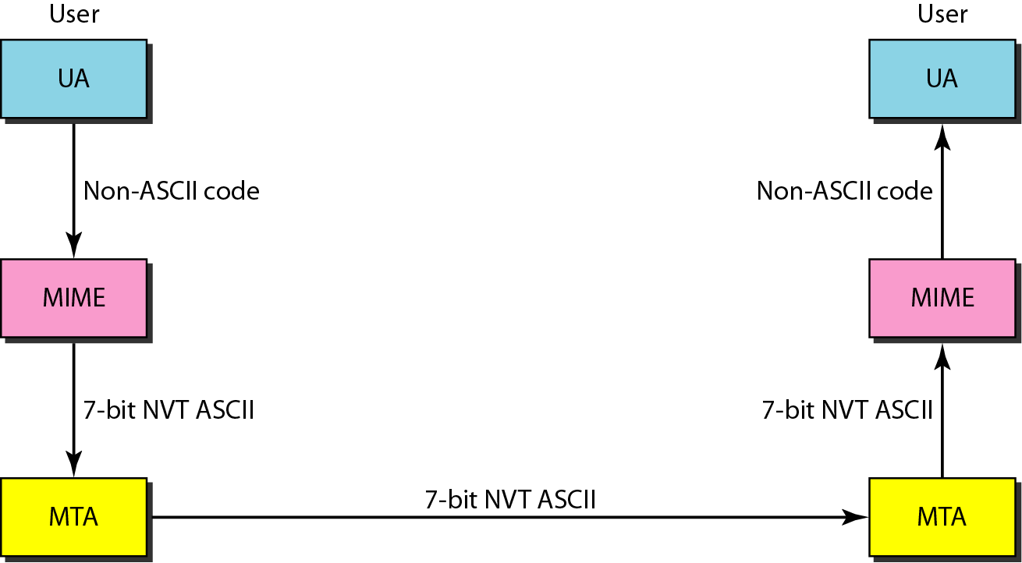
Figure 26.14 MIME

Slide 23
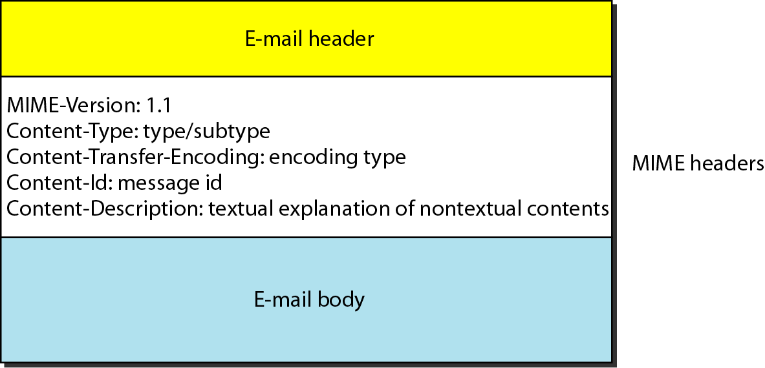
Figure 26.15 MIME header

Slide 24
Table 26.5 Data types and subtypes in MIME

Slide 25
Table 26.6 Content-transfer-encoding

Slide 26
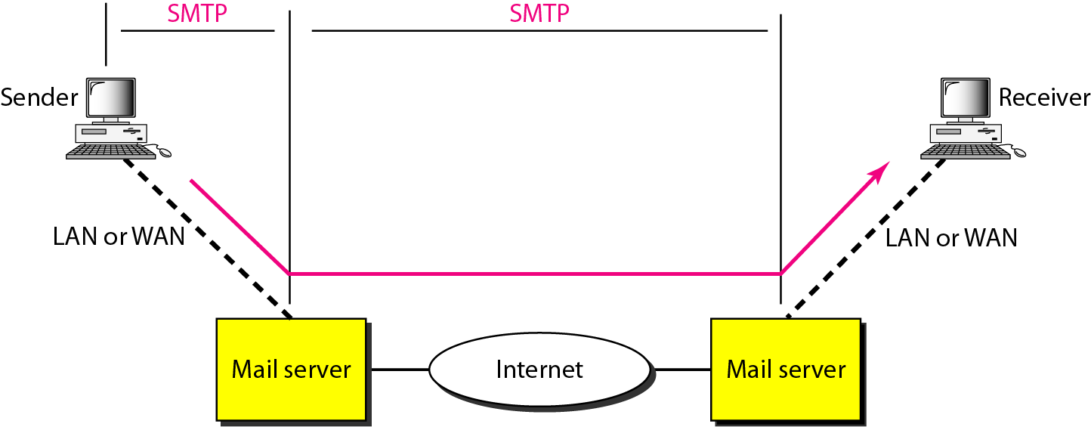
Message Transfer
Figure 26.16 SMTP range

Slide 27
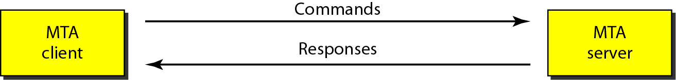
Figure 26.17 Commands and responses

Slide 28
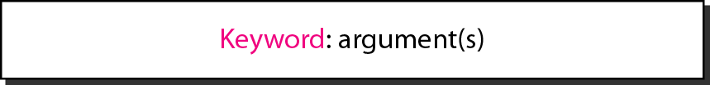
Figure 26.18 Command format

Slide 29
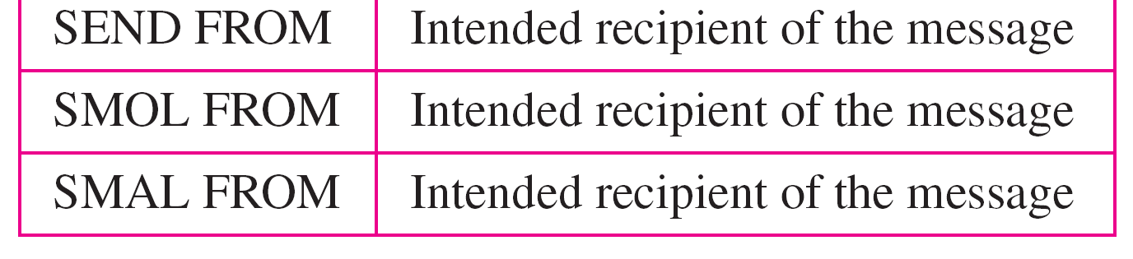
Table 26.7 Commands

Slide 30
Table 26.8 Responses

Slide 31
Table 26.8 Responses (continued)

Slide 32
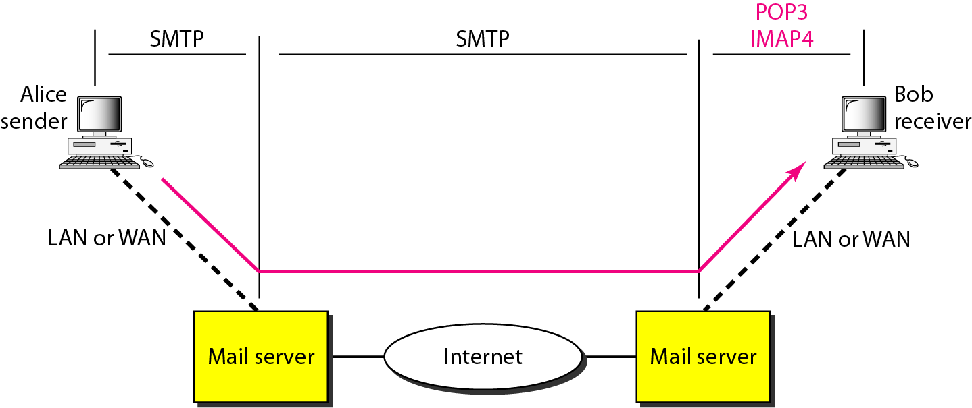
Final Delivery
Figure 26.19 POP3 and IMAP4

Slide 33
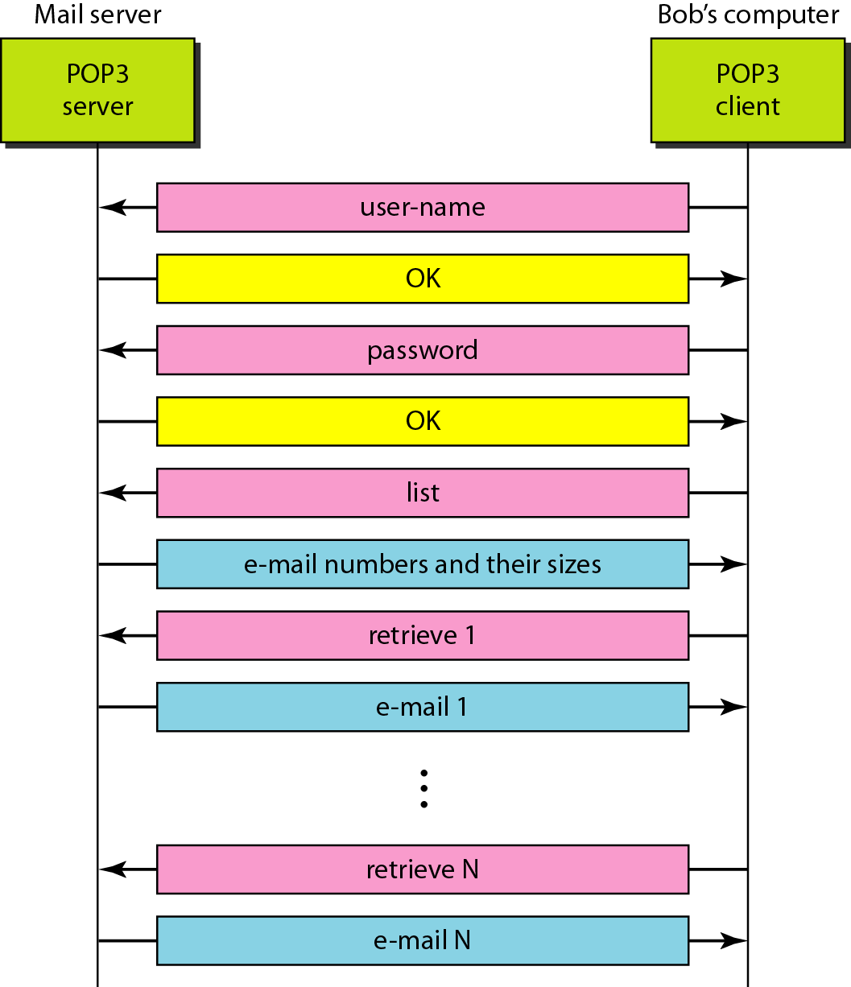
Figure 26.20 The exchange of commands and responses in POP3

Slide 34
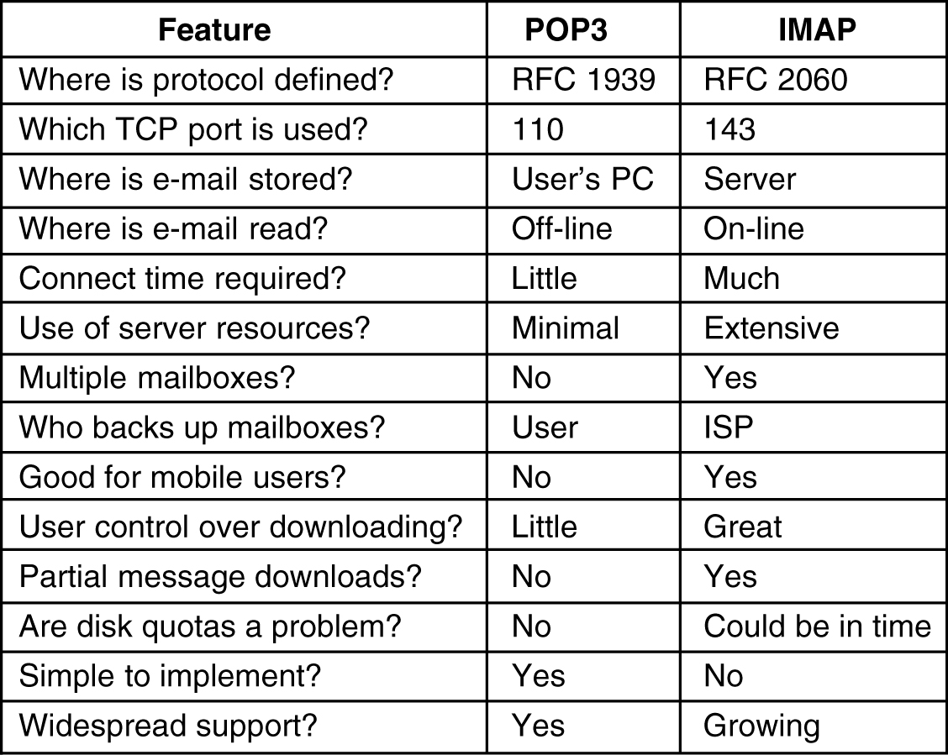
A comparison of POP3 and IMAP

Slide 35

Chapter 27
WWW and HTTP
Copyright © The McGraw-Hill Companies, Inc. Permission required for reproduction or display.

Slide 36
27-1 ARCHITECTURE
The WWW today is a distributed client/server service, in which a client using a browser can access a service using a server. However, the service provided is distributed over many locations called sites.
Topics discussed in this section:
Client (Browser) Server Uniform Resource Locator
Cookies

Slide 37
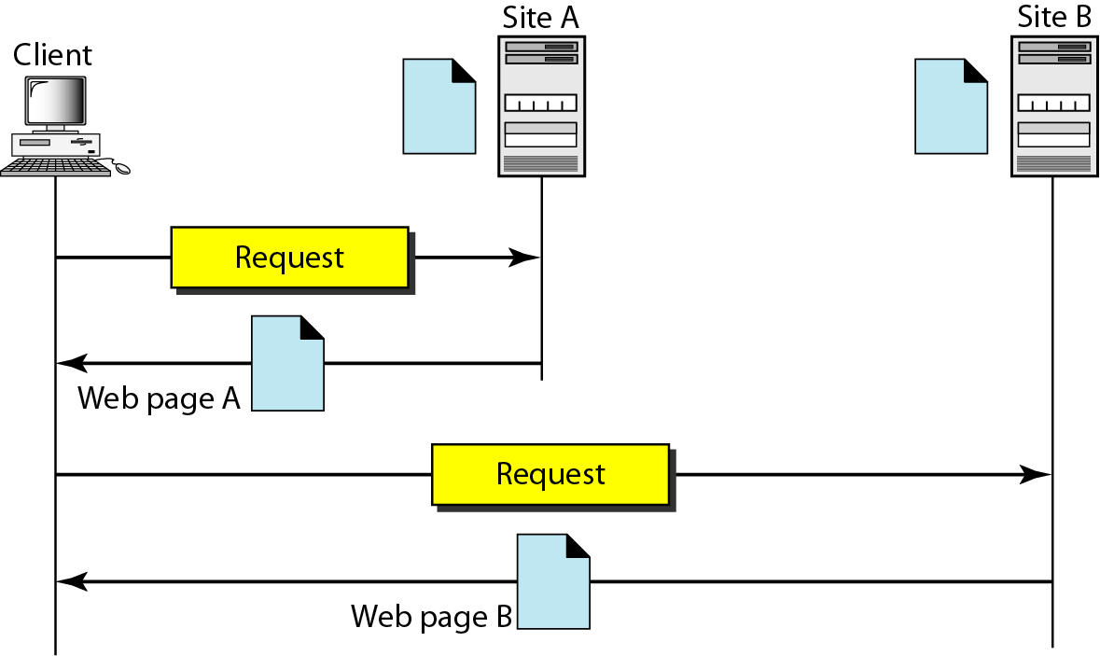
Figure 27.1 Architecture of WWW

Slide 38
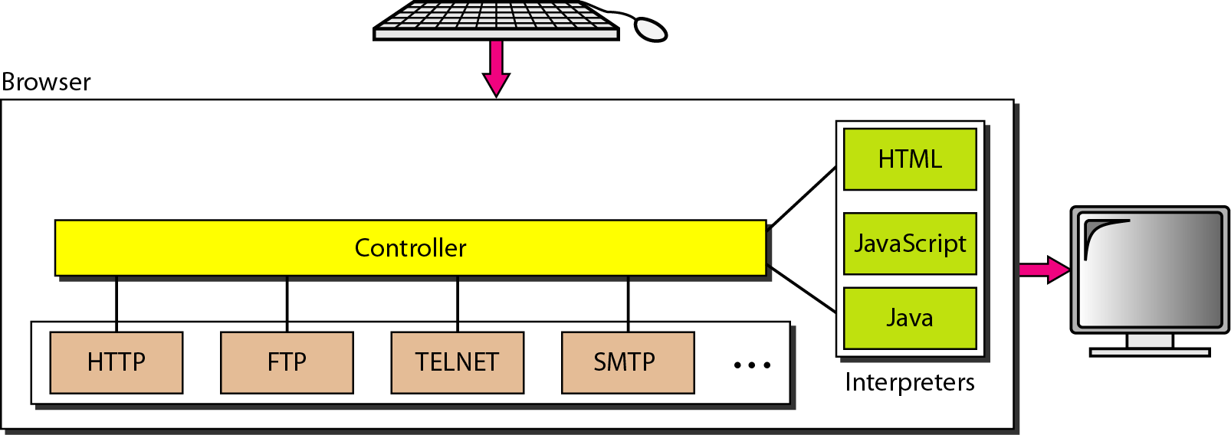
Figure 27.2 Browser

Slide 39
Figure 27.3 URL

Slide 40
27-2 WEB DOCUMENTS
The documents in the WWW can be grouped into three broad categories: static, dynamic, and active. The category is based on the time at which the contents of the document are determined.
Topics discussed in this section:
Static Documents
Dynamic Documents Active Documents

Slide 41
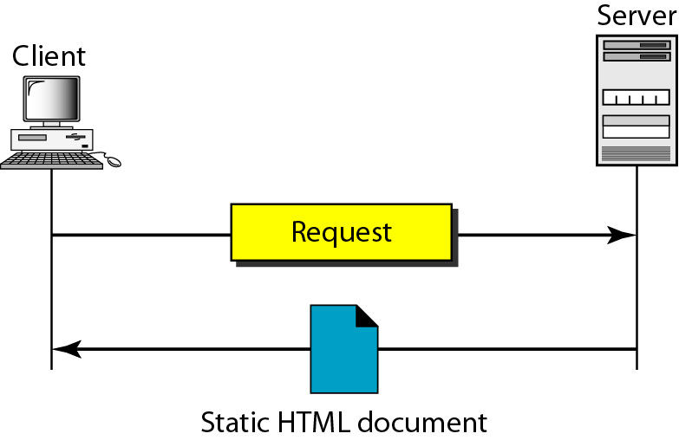
Figure 27.4 Static document

Slide 42
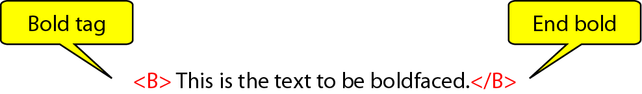
Figure 27.5 Boldface tags

Slide 43
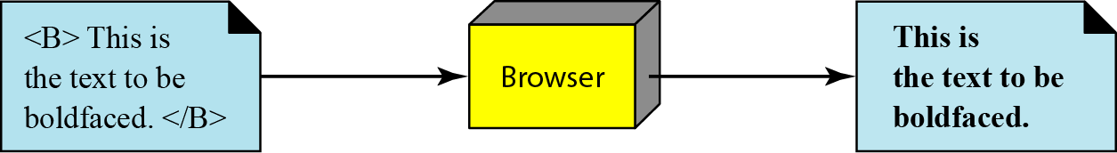
Figure 27.6 Effect of boldface tags

Slide 44
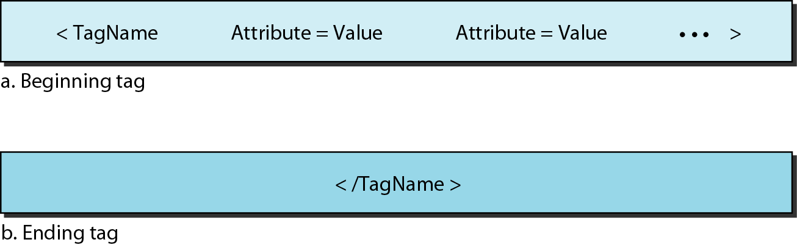
Figure 27.7 Beginning and ending tags

Slide 45
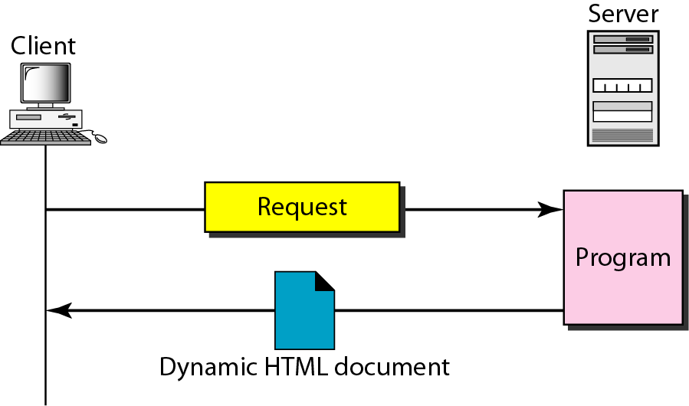
Figure 27.8 Dynamic document using CGI

Slide 46
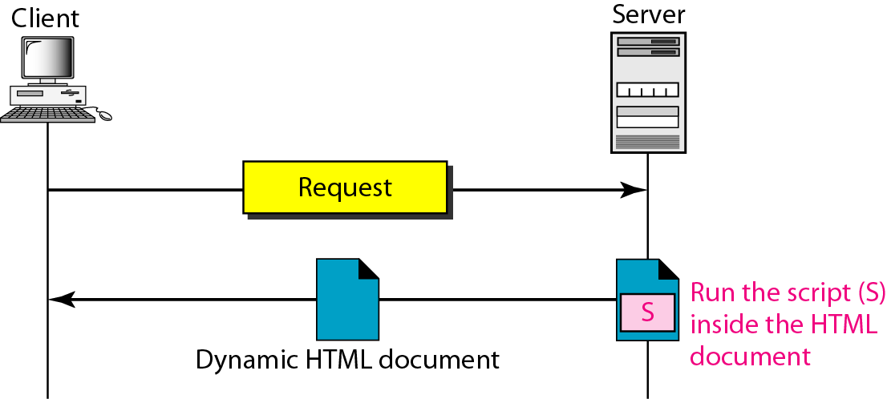
Figure 27.9 Dynamic document using server-site script

Slide 47

Note
Dynamic documents are sometimes referred to as server-site dynamic documents.

Slide 48
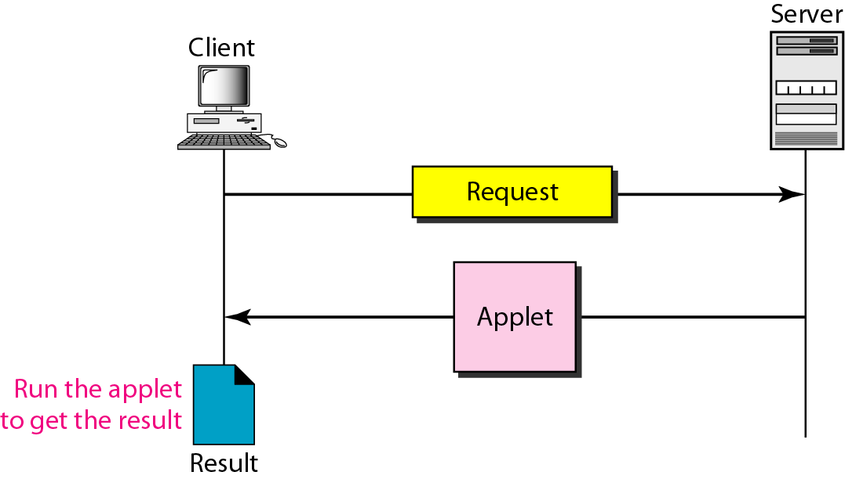
Figure 27.10 Active document using Java applet

Slide 49
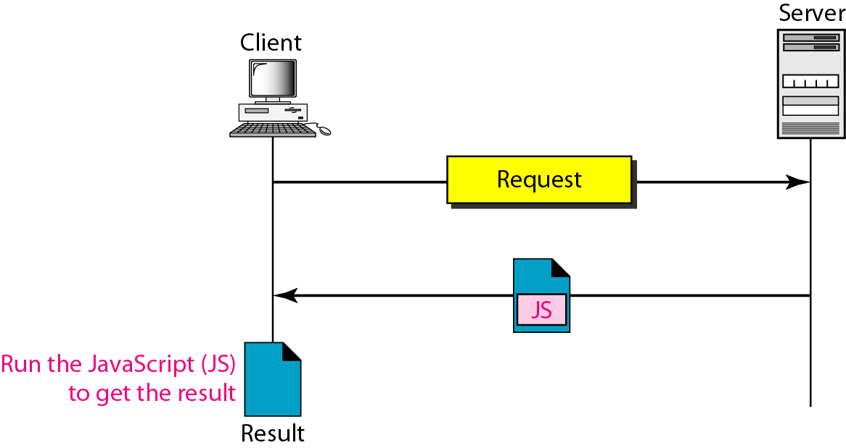
Figure 27.11 Active document using client-site script

Slide 50
Note
Active documents are sometimes referred to as client-site dynamic documents.

Slide 51
27-3 HTTP
The Hypertext Transfer Protocol (HTTP) is a protocol used mainly to access data on the World Wide Web. HTTP functions as a combination of FTP and SMTP.
Topics discussed in this section:
HTTP Transaction Persistent Versus Nonpersistent Connection

Slide 52
Note
HTTP uses the services of TCP on well-known port 80.

Slide 53
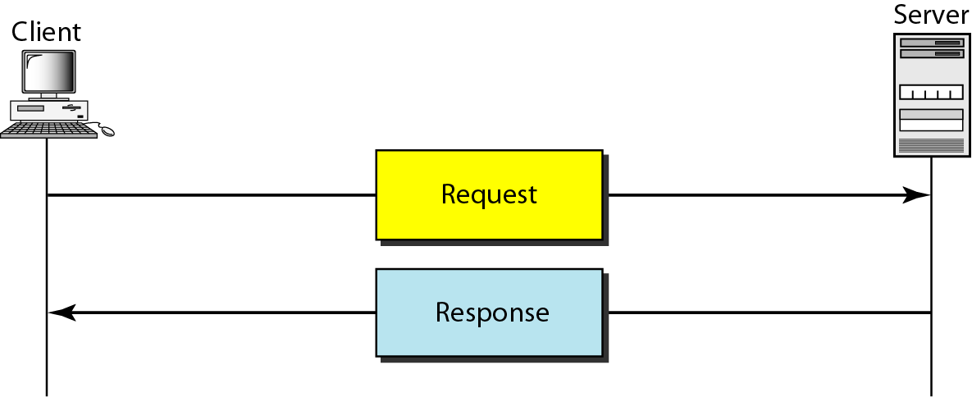
Figure 27.12 HTTP transaction

Slide 54
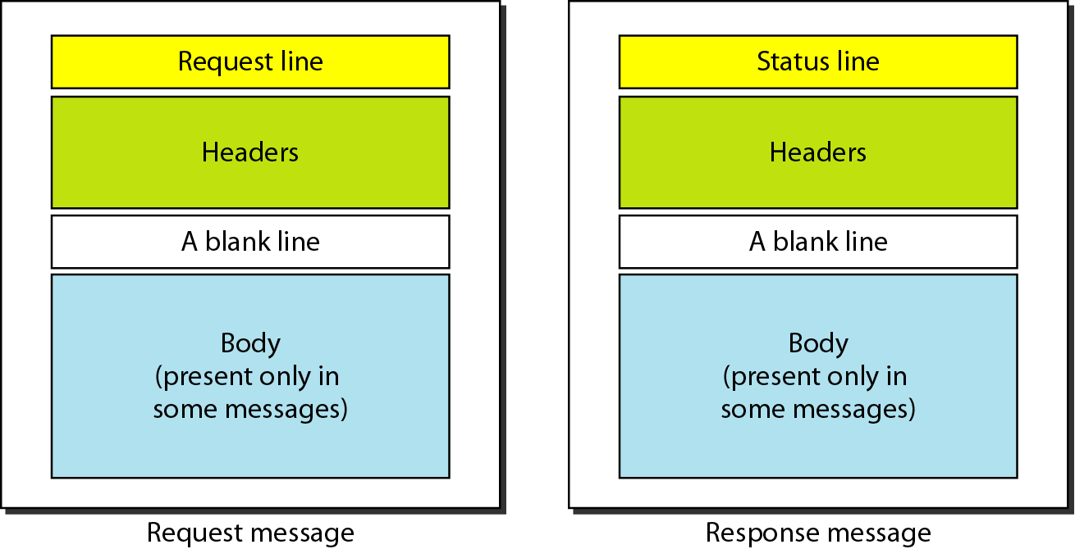
Figure 27.13 Request and response messages

Slide 55
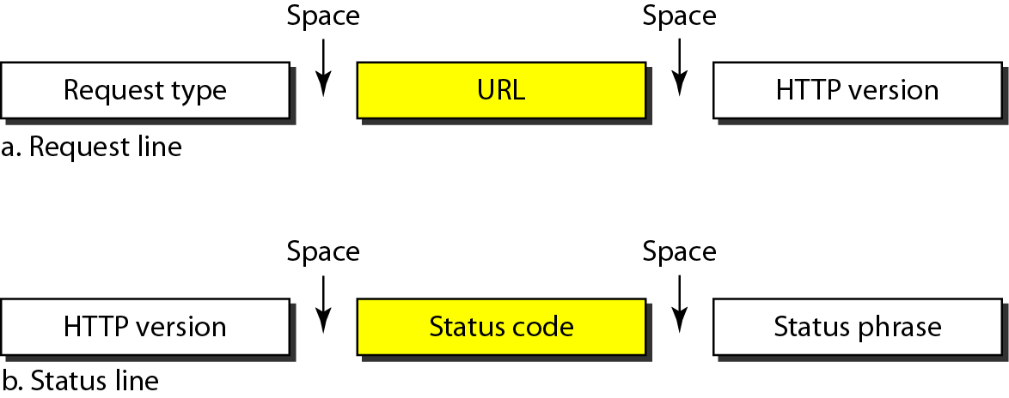
Figure 27.14 Request and status lines

Slide 56
Table 27.1 Methods of Request type

Slide 57
Table 27.2 Status codes

Slide 58
Table 27.2 Status codes (continued)

Slide 59
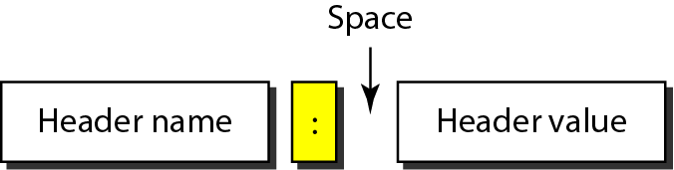
Figure 27.15 Header format
Header Types
Entity header
General header
Request header
Response header

Slide 60
Table 27.3 General headers

Slide 61
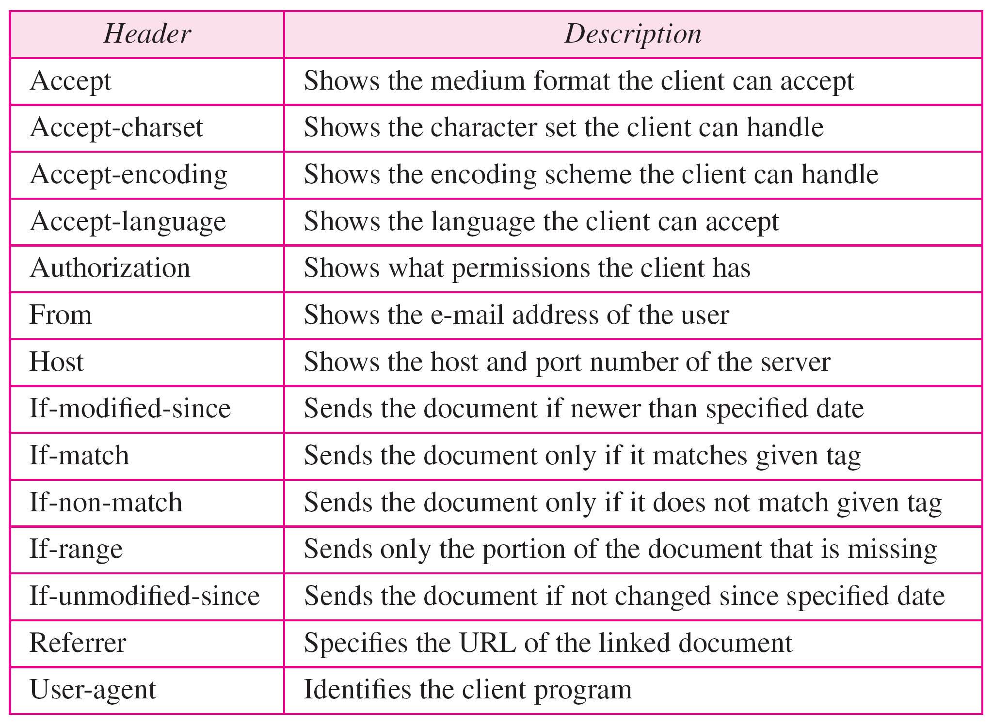
Table 27.4 Request headers

Slide 62
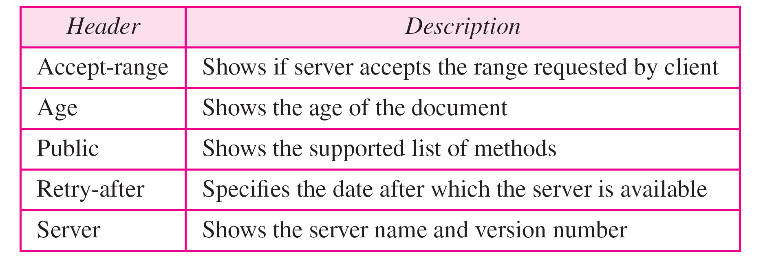
Table 27.5 Response headers

Slide 63
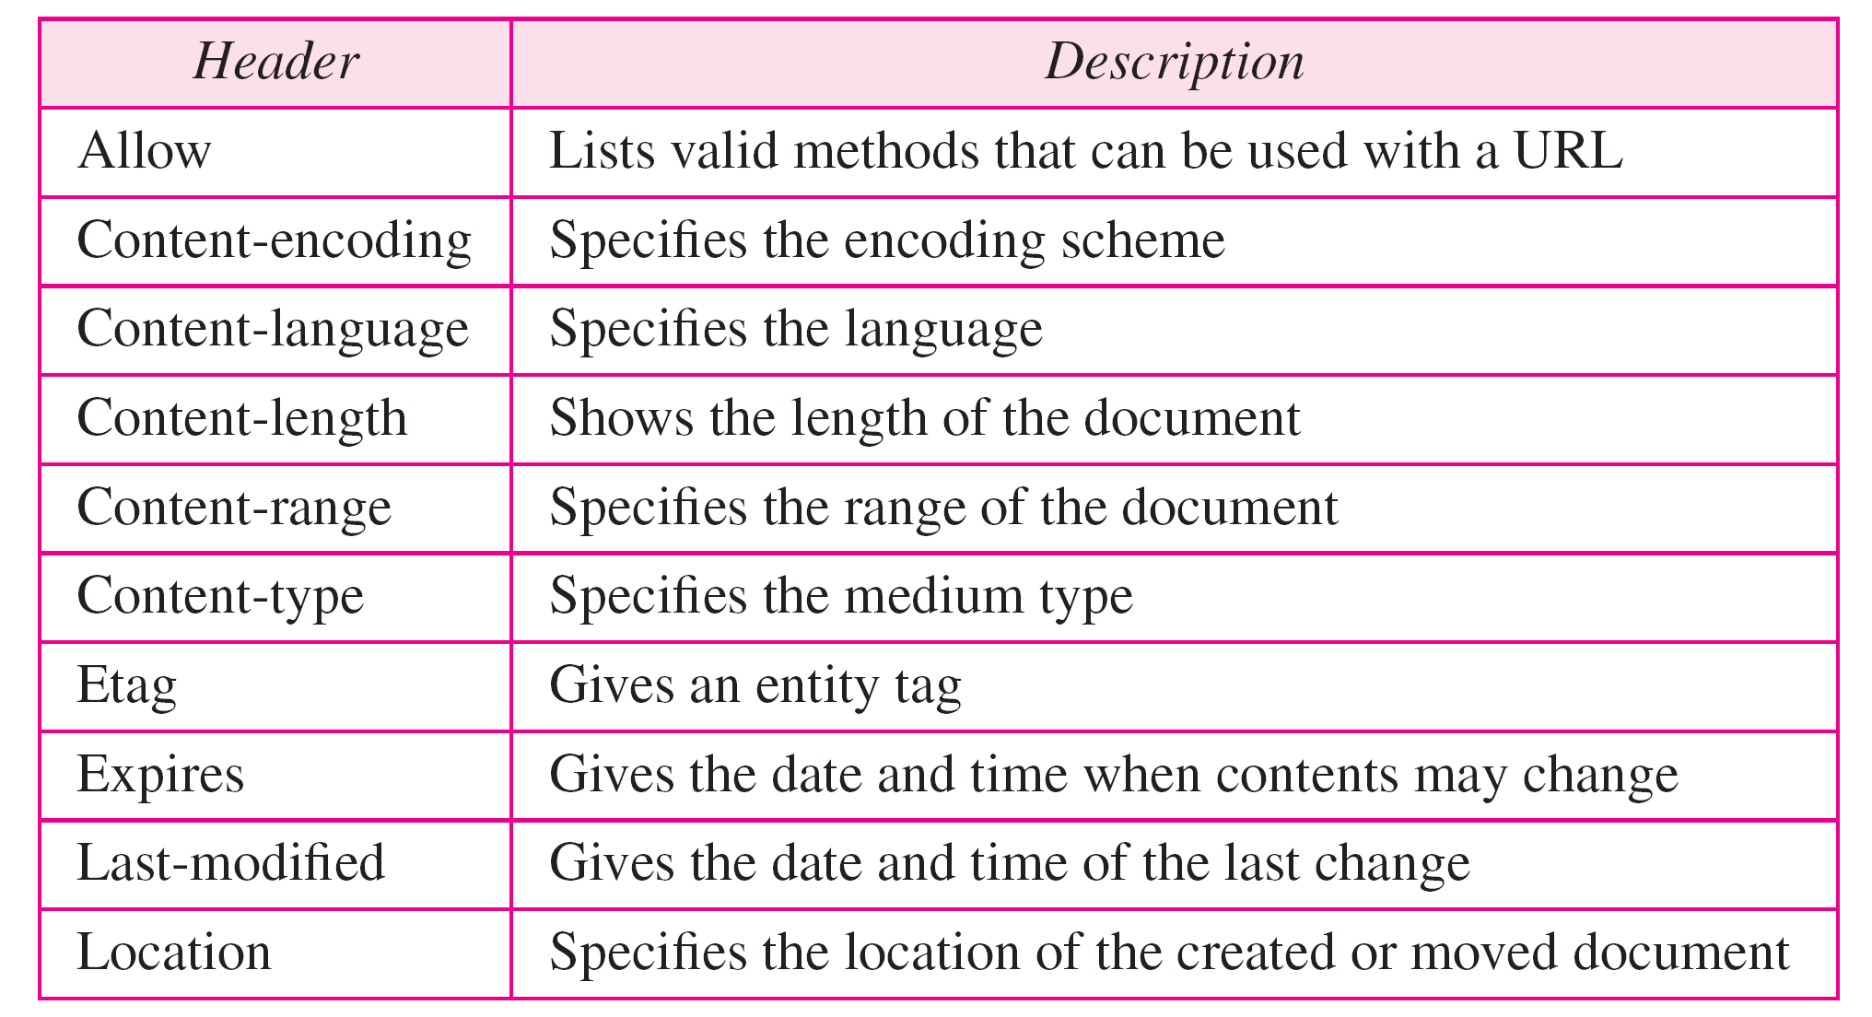
Table 27.6 Entity headers

Slide 64
Example 27.1
This example retrieves a document. We use the GET method to retrieve an image with the path /usr/bin/image1. The request line shows the method (GET), the URL, and the HTTP version (1.1). The header has two lines that show that the client can accept images in the GIF or JPEG format. The request does not have a body. The response message contains the status line and four lines of header. The header lines define the date, server, MIME version, and length of the document. The body of the document follows the header (see Figure 27.16).

Slide 65
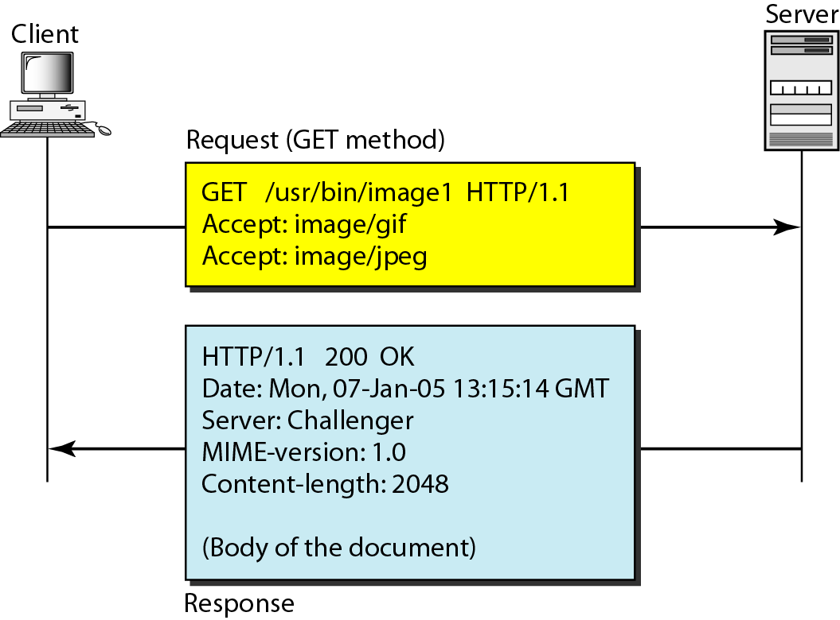
Figure 27.16 Example 27.1

Slide 66
Example 27.2
In this example, the client wants to send data to the server. We use the POST method. The request line shows the method (POST), URL, and HTTP version (1.1). There are four lines of headers. The request body contains the input information. The response message contains the status line and four lines of headers. The created document, which is a CGI document, is included as the body (see Figure 27.17).

Slide 67
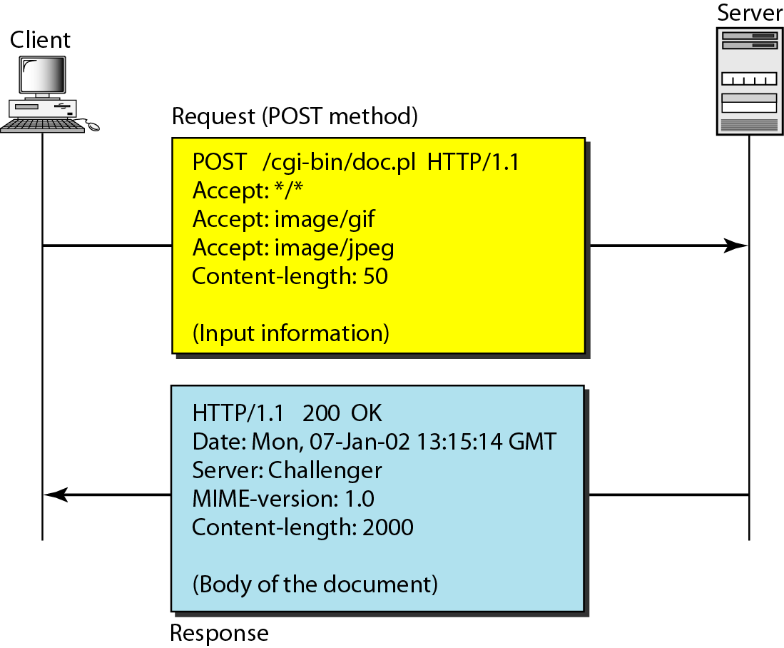
Figure 27.17 Example 27.2

Slide 68
Example 27.3
HTTP uses ASCII characters. A client can directly connect to a server using TELNET, which logs into port 80 (see next slide). The next three lines show that the connection is successful. We then type three lines. The first shows the request line (GET method), the second is the header (defining the host), the third is a blank, terminating the request. The server response is seven lines starting with the status line. The blank line at the end terminates the server response. The file of 14,230 lines is received after the blank line (not shown here). The last line is the output by the client.

Slide 69
Example 27.3 (continued)

Slide 70
Persistent Versus Nonpersistent Connection
In a nonpersistent connection, one TCP connection is made for each request/response.
The following lists the steps in this strategy:
1. The client opens a TCP connection and sends a request.
2. The server sends the response and closes the connection.
3. The client reads the data until it encounters an end-of-file marker; it then closes the connection.
In a persistent connection, the server leaves the connection open for more requests after sending a response.
The server can close the connection at the request of a client or if a time-out has been reached.
HTTP version 1.1 specifies a persistent connection by default.

Slide 71
Proxy Server
HTTP supports proxy servers.
A proxy server is a computer that keeps copies of responses to recent
The HTTP client sends a request to the proxy server.
The proxy server checks its cache.
If the response is not stored in the cache, the proxy server sends the request to the corresponding server. Incoming responses are sent to the proxy server and stored for future requests from other clients.
The proxy server reduces the load on the original server, decreases traffic, and improves latency.
To use the proxy server, the client must be configured to access the proxy instead of the target server. requests.

